Slide 1

REACHING for
THE SKY
EMPOWERING GIRLS THROUGH EDUCATION
URVASHI SAHNI
Publication Year: 2017
Published by: Brookings Institution Press

Slide 2

Dr Urvashi Sahni is a social entrepreneur, women rights activist and educationist. Through her various organizations, she has been working for the rights of children and women for over three decades.

Slide 3
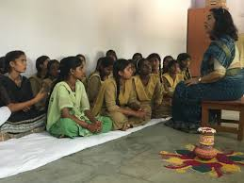
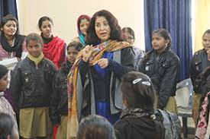
Letting girls learn

Slide 4
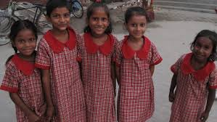
Laxmi
Domestic help since the age of 7.
Her Mother was married at 12 and gave birth to 7 children in 23 years and died at 35 in 2005.
Laxmi joined Prerna school in 2004.
Her school fee was Rs 10 and classes were held in the afternoon.
She left for work at 6 in the morning after making breakfast at home.
She returned at noon , reached school at 1 o’ clock and again from school went directly to work.
Reached home around 9 o’clock, cooked dinner and finally got into bed at 11p.m.

Slide 5
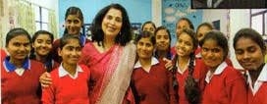
PRERNA , a school for the underprivileged girls was started in 2003 for girls with lives like hers.

Slide 6
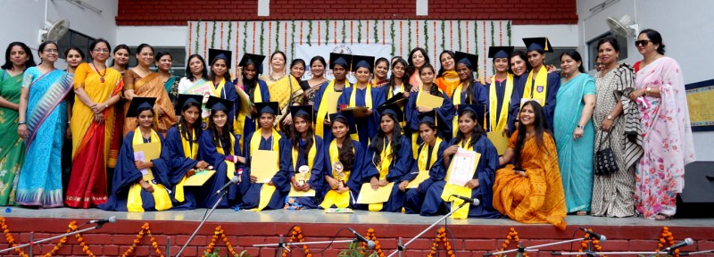
Today Laxmi has finished college and is working earning 2500 per month!

Slide 7
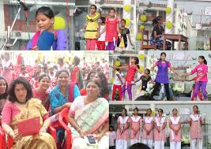
This book tells the story of Prerna
describing how it provided a safe and supportive environment so that girls like Laxmi could stay, learn. grow and become empowered to make
their lives better.

Slide 8
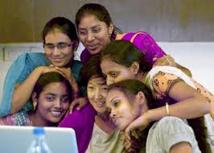
Being a girl

Slide 9
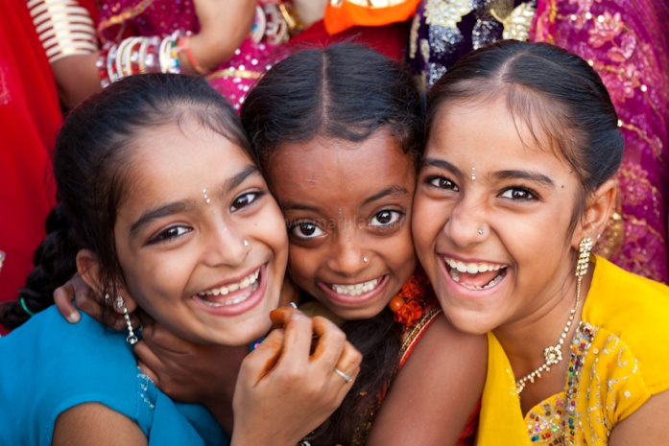
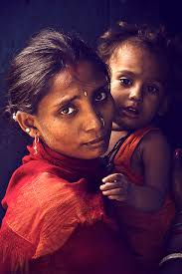
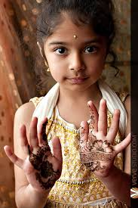
In a survey conducted in 2007 , Indian girls were asked if they liked being girls..
48.4% said NO

Slide 10

one million girls are killed before birth as a result of selective abortions

Slide 11

Barriers to education

Slide 12
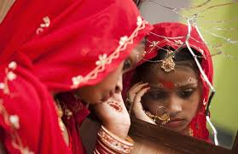
Of the 15 million child brides in the world one-third belong to india
Child marriage

Slide 13
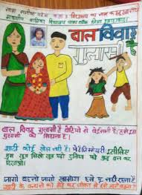
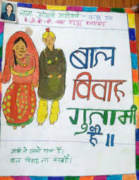
Child marriages are arranged by parents,without the consent of the children so in effect girls are given into a physical, economic, psychological and sexual bondage

Slide 14
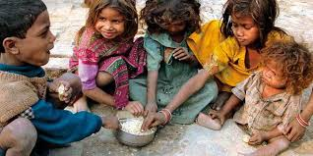
Education of girls is low on the value scale for poor families
Another barrier to education is poverty and gender

Slide 15

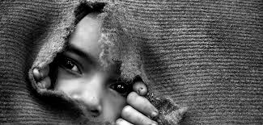
Drop out or push out
Schools do nothing to keep them in.
School environment is seen as unsafe and unfriendly, and the teachers too convey their low expectations from a girl child.

Slide 16

The promise of girl education

Slide 17
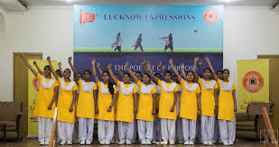

The world discourse around girls education is driven largely by the efficiency argument rather than the right based one

Slide 18
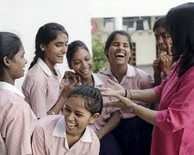
The central contention of this book is that educating girls is important for the simple reason that it is the girls right to be educated and not just because the society benefits.

Slide 19
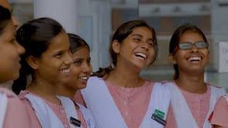
Education, empowerment and gender equality

Slide 20
EMPOWERMENT
Dr. Sahani defines it as a process of developing feminist consciousness, which involves gaining a critical understanding of one’s political and social reality

Slide 21
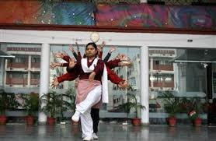
Empowerment and Education
Necessary correlation?

Slide 22
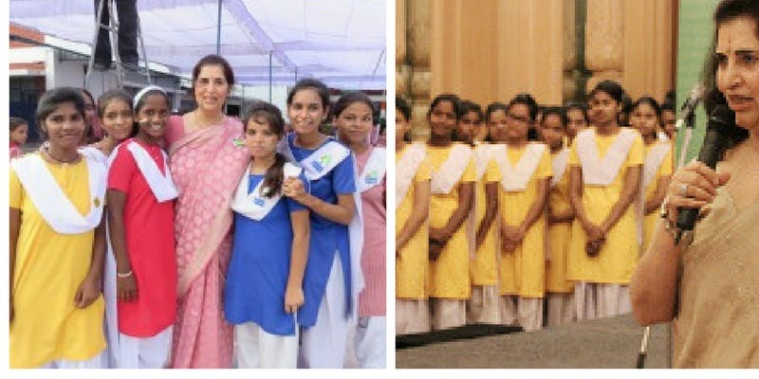
Education empowers only if
It builds women’s self confidence,
Improves her position in the society and
Challenges inequalities.

Slide 23
curricular content,
Pedagogical practices and
Organizational structures
This requires relevant changes in the

Slide 24
An empowering education
PRERNA
Transforming girls lives

Slide 25
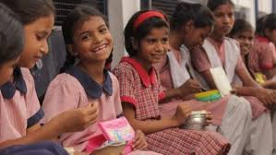
Prerna
Welcomes the girl students
Looks at their lives closely
Tries to understand the challenges they face
Fights hard for them
Resists pressure to pull them out of school
Is inexpensive
And the timings are fitted to suit their demanding schedules

Slide 26


